Slide 1
Slides prepared for BIRN ONTOLOGY WORKSHOP
(slimmed down version)
Stanford Feb. 2006
Barry Smith

Slide 2
These are the kinds of queries BIRN’s ontology resources are supposed to help with
  Find all datasets of schizophrenics with structural and functional imaging data related to working memory
  Find the correlation between hippocampal volume and working memory performance in AD subjects

Slide 3
This is what they were doing in early 2006
My question:
Can we reason on the basis of a graph of this sort?
Behavioral Paradigm
Assessment
SCID-Patient
SIRP
CVLT
Breathhold
Working memory
Long Term memory
Attention
Memory
Cognitive Process
Action
Notes:
Need to create neuropsychological/neuropsychiatric ontologies and link to neuroanatomical ontology infrastructure

Slide 4
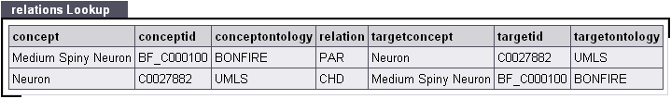
Bonfire Relations
relation:
the type of relation between the concept to the left and the concept to the right
PAR = Parent
CHD = Child
SIB = Sibling
RB = Broader Relationship
RN = Narrower Relationship
RO = Other Relationship
They should have replaced these
with well-defined formal relations from
http://obo.sourceforge.net/relationship/

Slide 5
BIRN Relations
They should have replaced these
with well-defined formal relations
UMLS (PAR, CHD, RN, RO, RB, SY).
RB: has a broader relationship
RN: has a narrower relationship
RO: has relationship other than synonymous, narrower, or broader
CHD: has child relationship in a Metathesaurus
SIB: has sibling relationship in a Metathesaurus source vocabulary

Slide 6
Areas where application ontologies will be needed
Participant demographics such as age, gender, …
Clinical and psychiatric information
  Assessments used, data type
  Diagnostic information
Behavioral data during fMRI tasks
  Need to know how to interpret that (“is a button 1 response a yes or a no?”)
Raw structural and functional images
  Need information about data collection and preprocessing methods
Single-subject and group level analyses and results
  Need information about analytic methods used
OBI is supposed to help here:
http://obi.sourceforge.net/
Notes:
So as you have seen,

Slide 7
Ontology/Terminology Infrastructure
  In addition, the ontology will provide a semantic network; for a user searching for “memory" information, related information would include
  Cognitive terms, e.g., recall, recognition, short and long term memory
  Assessment terms, e.g., California Verbal Learning Test
  “Disorders of” terms, e.g., Alzheimer’s disease is a disorder of memory
The problem here:
How will they block information overload?

Slide 8
BIRN’s relies on Neuronames
Since univocity is not enforced in the literature of neuroanatomy, e.g. the term ‘Basal ganglia’ represents different structures when used in association with anatomic, functional and clinical views.
The problem here:
How will BIRN resolve or clarify this?

Slide 9
Neuronames
gives no explicit definitions, and the representations it gives (e.g. of the Fourth Ventricle*) are often at odds with consensual usage
hence scalability, extendability, combinability with other ontologies is limited – how then can it be used to bridge research efforts at the genomic / proteomic level with those at the clinical level?
Information unique to neuroanatomical entities such as axonal input/output relationships, connectivity, neuron type, neurotransmitter and receptor types are indispensable in establishing and understanding both structural and physiological relationships among neuroanatomical entities and their relationship with the rest of the body.
Notes:
this is standardly regarded as a space, but is represented in NN as consisting of a wall (choroid plexus and membrane), a space (unnamed) and cerebrospinal fluid.

Slide 10
BIRNLex (in early 2006)
The eye =def.
The eyeball and its constituent parts, e.g. retina
mouse =def.
common name for the species mus musculus
have these problems been fixed?

Slide 11
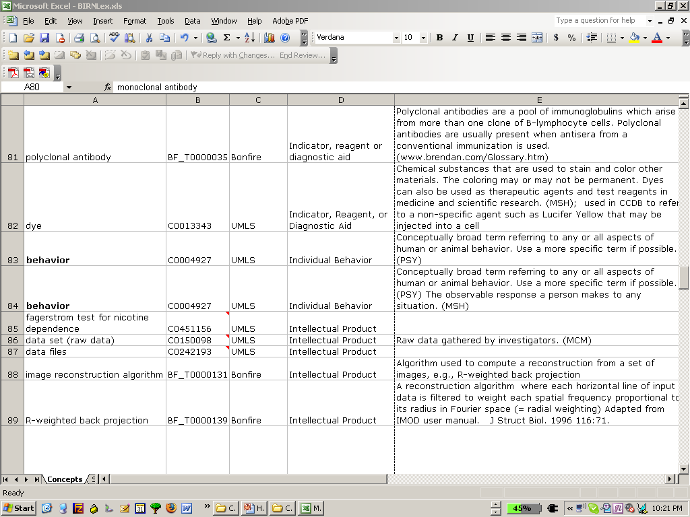
BIRNLex
have these problems been fixed?

Slide 12
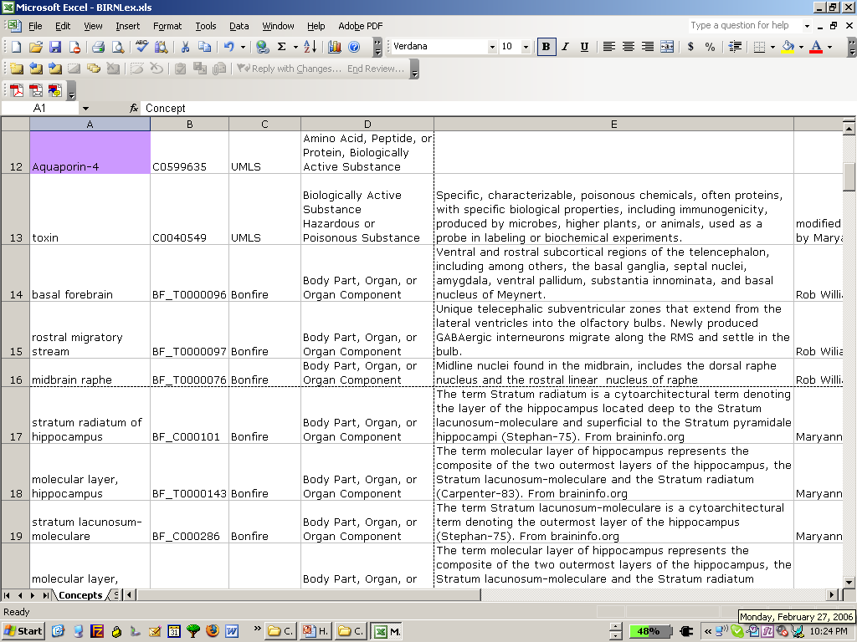
BIRNLex
have these problems been fixed?

Slide 13
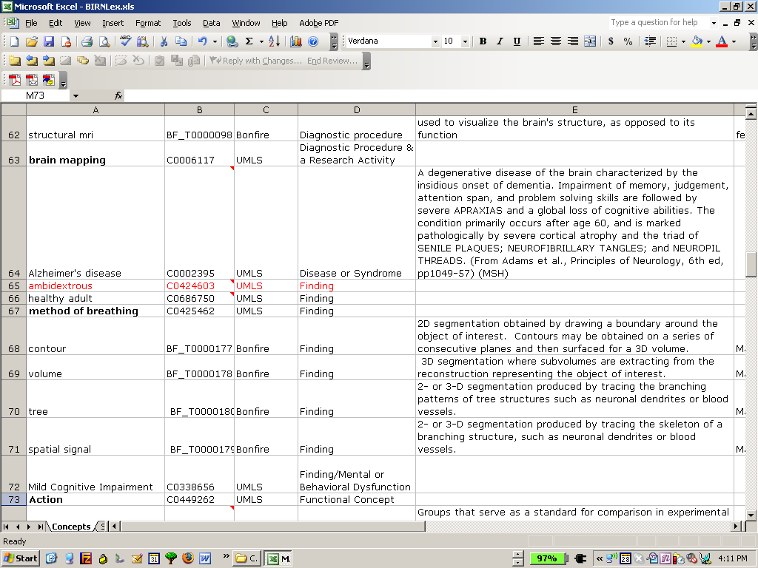
BIRNLex
have problems in use of ‘Finding’ been fixed?
a tree is a finding!

Slide 14
BIRNLex
how have they solved
the problem of making their ontology
interoperable with
other ontologies

Slide 15
BIRNLex
bear in mind always that
this ontology needs
to be interoperable with
other ontologies

Slide 16
BIRNLex
surface =def 3D segmentation obtained by fitting a polygonal mesh around the boundary of an object of interest, creating a 3D surface
Concept =def Generic ideas or categories derived from common properties of objects, events, or qualities, usually represented by words or symbols
mixture of singular and plural nouns

Slide 17
BIRNLex
brain imaging =def none; synonymous with positrocephalogram, nos [‘not otherwise specified’]
CA1 =def CA1 cytoarchitectonic field of hippocampus
cognitive process = def. conceptual function or thinking in all its forms
typical mistakes inherited from UMLS

Slide 18
BIRNLex and UMLS-SN
Rest =SN Daily or Recreational Activity
Principal Investigator =SN Professional or Occupational Group
Left handedness =SN Organism Attribute
Ambidextrous =SN Finding
Brain Imaging =SN Diagnostic Procedure
Brain Mapping =SN Diagnostic Procedure & Research Activity
Healthy Adult =SN Finding
typical mistakes inherited from UMLS

Slide 19
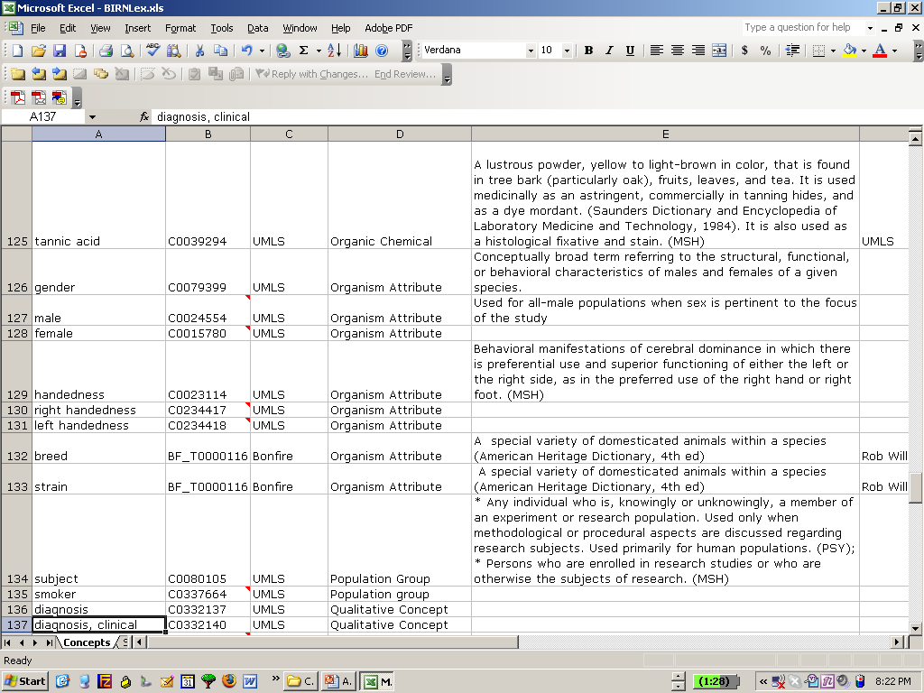
BIRNLex
typical mistakes inherited from UMLS

Slide 20
Anatomical Knowledge Sources
Foundational model of anatomy
Neuronames (Brain Info)***
BAMS***
Adult Mouse Anatomical Dictionary (Edinburgh/GO)
the problem is that UMLS is a ragbag of good and
(mostly) bad; it is not internally coherent;
see http://obofoundry.org for the alternative approach
“Although BIRN is an open, diverse and fluid environment, the use of ontologies for enhanced interoperability will be pointless if we allow random use of ontologies. The OTF recommends that there be a set of ontologies that are approved for use and a set of policies and procedures for adding or creating additional knowledge sources. Current knowledge sources that are currently in use include UMLS, GO, LOINC, SNOMED, NEURONAMES.”
-OTF report to BEC 8/05

